Slide 1



Slide 2


Slide 3
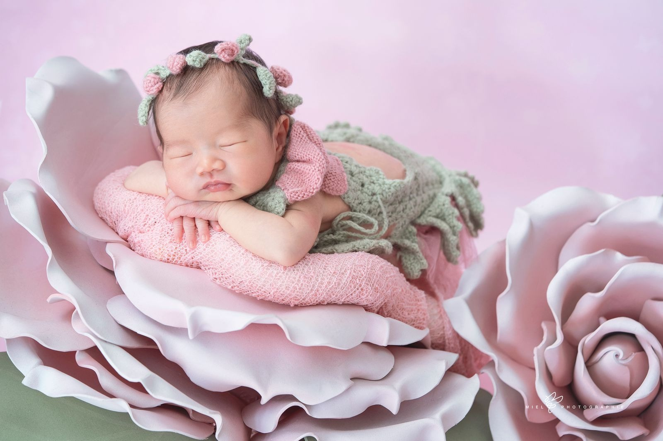


Slide 4

WEEK 7
RAISING LAZARUS FROM THE DEATH

Slide 5
John 11
1 Now a certain man was ill, Lazarus of Bethany, the village of Mary and her sister Martha. 2 It was Mary who anointed the Lord with ointment and wiped his feet with her hair, whose brother Lazarus was ill. 3 So the sisters sent to him, saying, “Lord, he whom you love is ill.” 4 But when Jesus heard it he said, “This illness does not lead to death. It is for the glory of God, so that the Son of God may be glorified through it.”

Slide 6
John 11
5 Now Jesus loved Martha and her sister and Lazarus. 6 So, when he heard that Lazarus was ill, he stayed two days longer in the place where he was.

Slide 7
John 11
14 Then Jesus told them plainly, “Lazarus has died, 15 and for your sake I am glad that I was not there, so that you may believe. But let us go to him.”

Slide 8
John 11
17 Now when Jesus came, he found that Lazarus had already been in the tomb four days. 18 Bethany was near Jerusalem, about two miles off, 19 and many of the Jews had come to Martha and Mary to console them concerning their brother.

Slide 9
John 11
20 So when Martha heard that Jesus was coming, she went and met him, but Mary remained seated in the house. 21 Martha said to Jesus, “Lord, if you had been here, my brother would not have died .22 But even now I know that whatever you ask from God, God will give you.”

Slide 10
John 11
24 Jesus said to her, “Your brother will rise again.” Martha said to him, “I know that he will rise again in the resurrection on the last day.” 25 Jesus said to her, “I am the resurrection and the life. Whoever believes in me, though he die, yet shall he live, and everyone who lives and believes in me shall never die. Do you believe this?”

Slide 11
John 11
32 Now when Mary came to where Jesus was and saw him, she fell at his feet, saying to him, “Lord, if you had been here, my brother would not have died.” 33 When Jesus saw her weeping, and the Jews who had come with her also weeping, he was deeply moved in his spirit and greatly troubled.

Slide 12
John 11
35 Jesus wept.

Slide 13
John 11
38 Then Jesus, deeply moved again, came to the tomb. It was a cave, and a stone lay against it. 39 Jesus said, “Take away the stone.” Martha, the sister of the dead man, said to him, “Lord, by this time there will be an odor, for he has been dead four days.” 40 Jesus said to her, “Did I not tell you that if you believed you would see the glory of God?”

Slide 14
John 11
43 When he had said these things, he cried out with a loud voice, “Lazarus, come out.” 44 The man who had died came out, his hands and feet bound with linen strips, and his face wrapped with a cloth. Jesus said to them, “Unbind him, and let him go.”

